Slide 1

Topologies for LLM Training
SimAI Comparisons

Slide 2

Simulations Configurations
Models and Parameters Used
Models used:
GPT: 7,13,22,175B
Llama: 405B
World Sizes:
64
128
512
1024
2048
4096
Parallelism Methods:
Tensor Parallelism
Pipeline Parallelism
Data Parallelism
Expert Parallelism (MoE only)
Batch Size Parameters:
Global Batch Size
Micro Batch Size
Sequence Length
Architectures Compared:
MoE based (16 experts)
Densed
Topologies Compared:
Fat Tree
DragonFly+
Hyperx
Total 123 setups per architecture

Slide 3
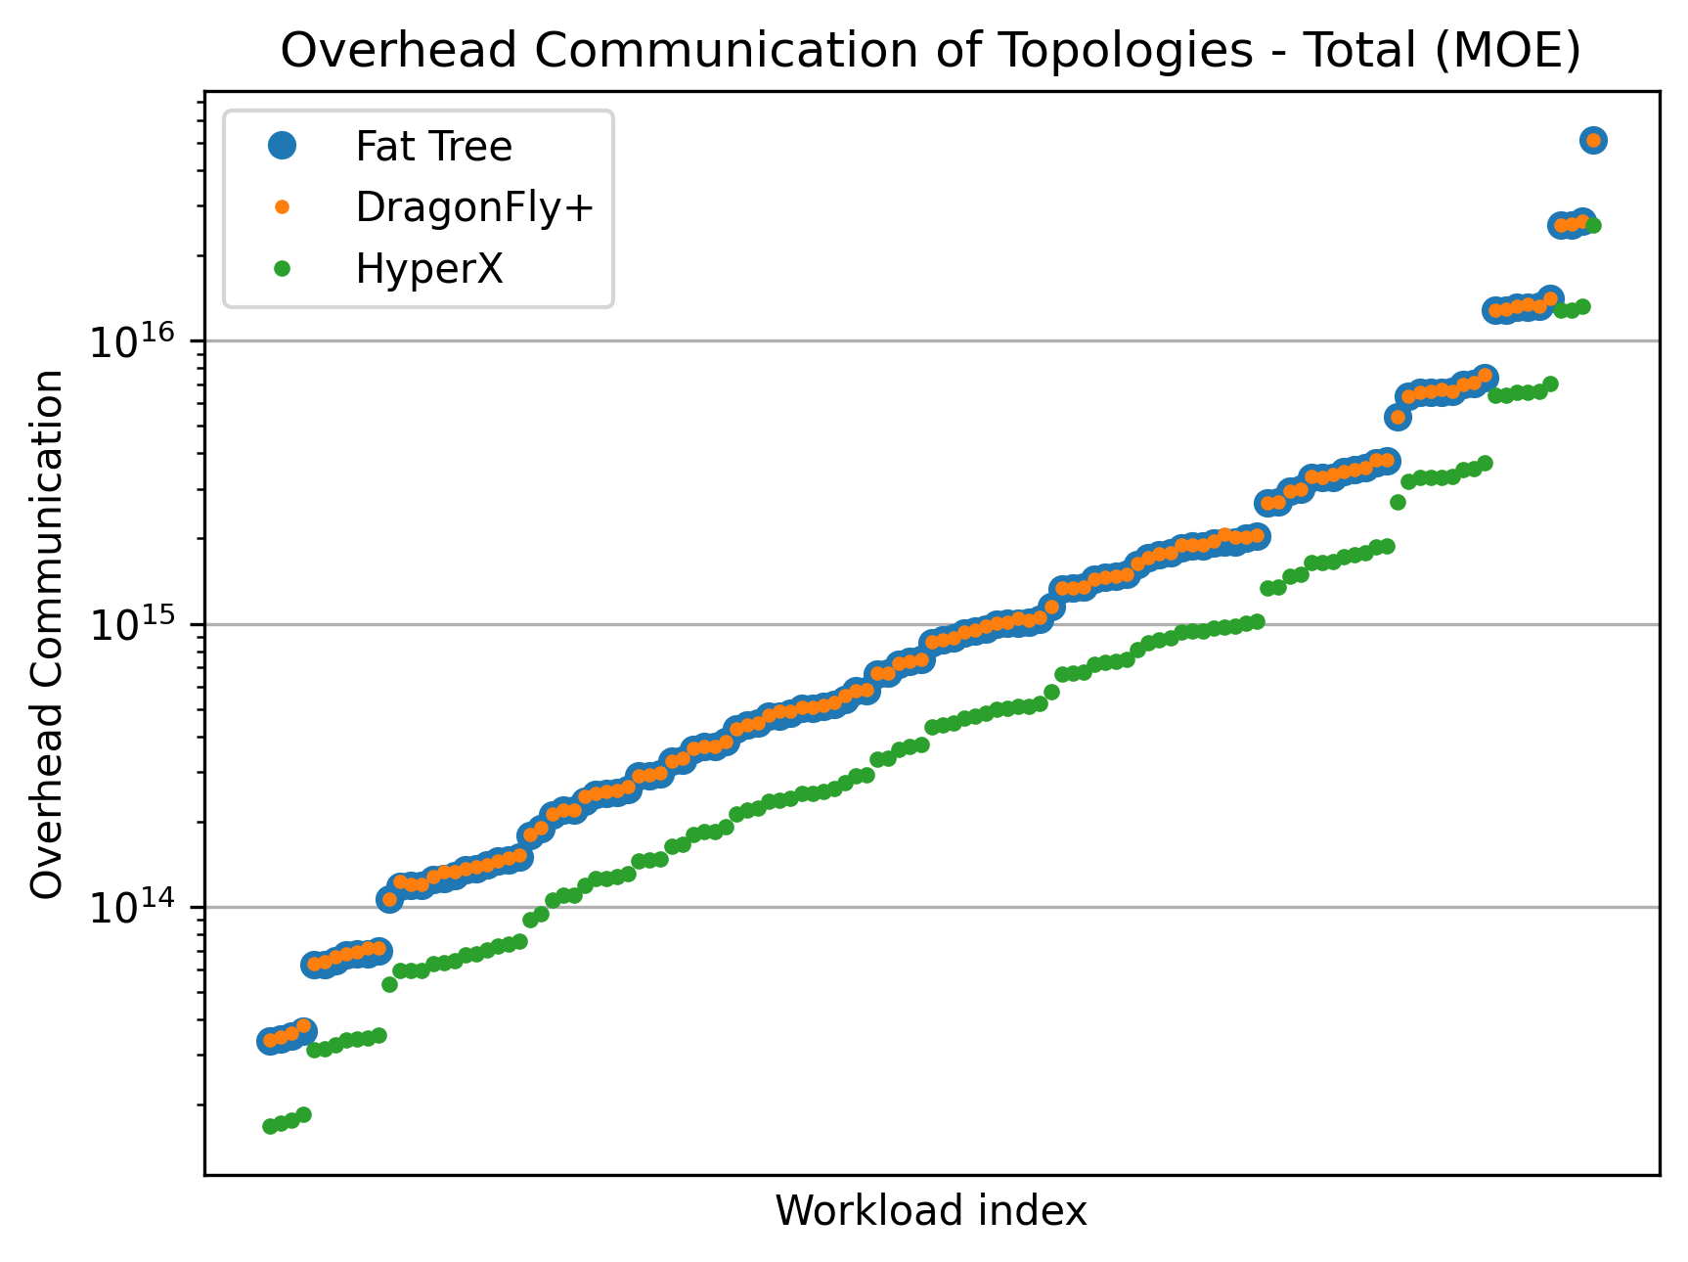
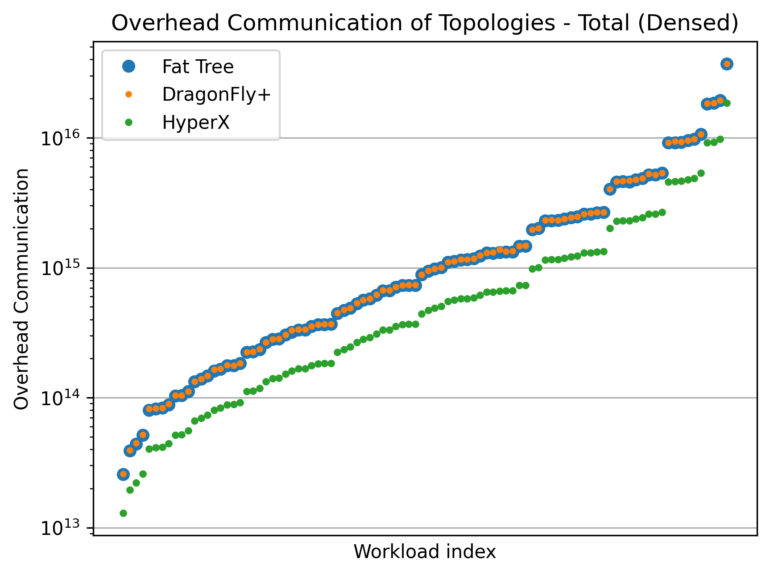
Overall Overhead Comparison
High Level Comparison of Each Topology Over Architecture Framework

Slide 4
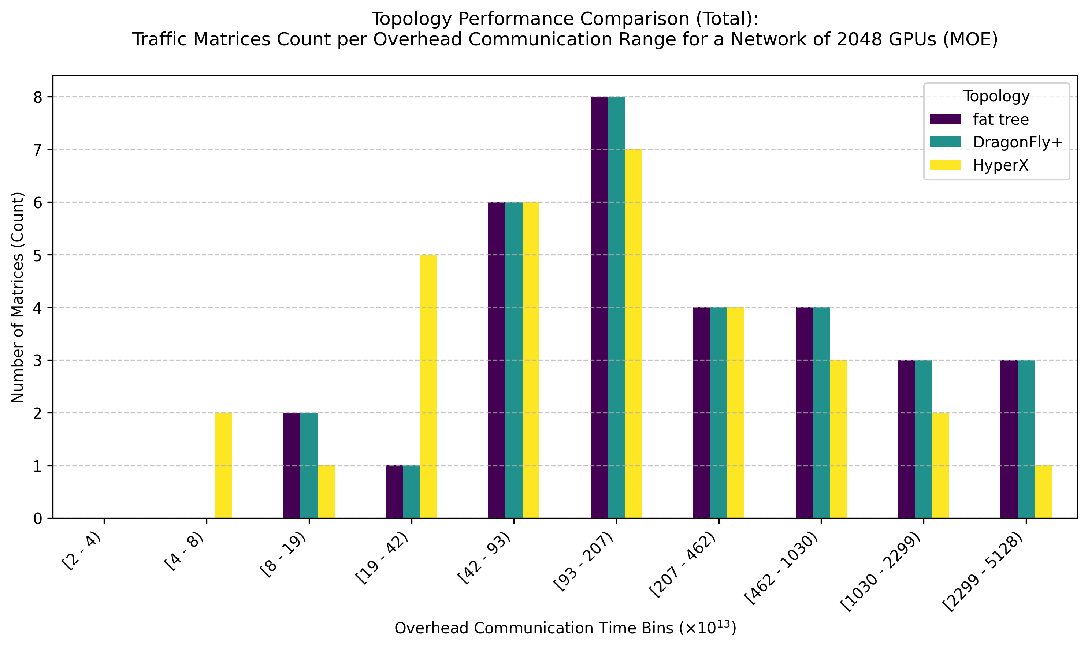
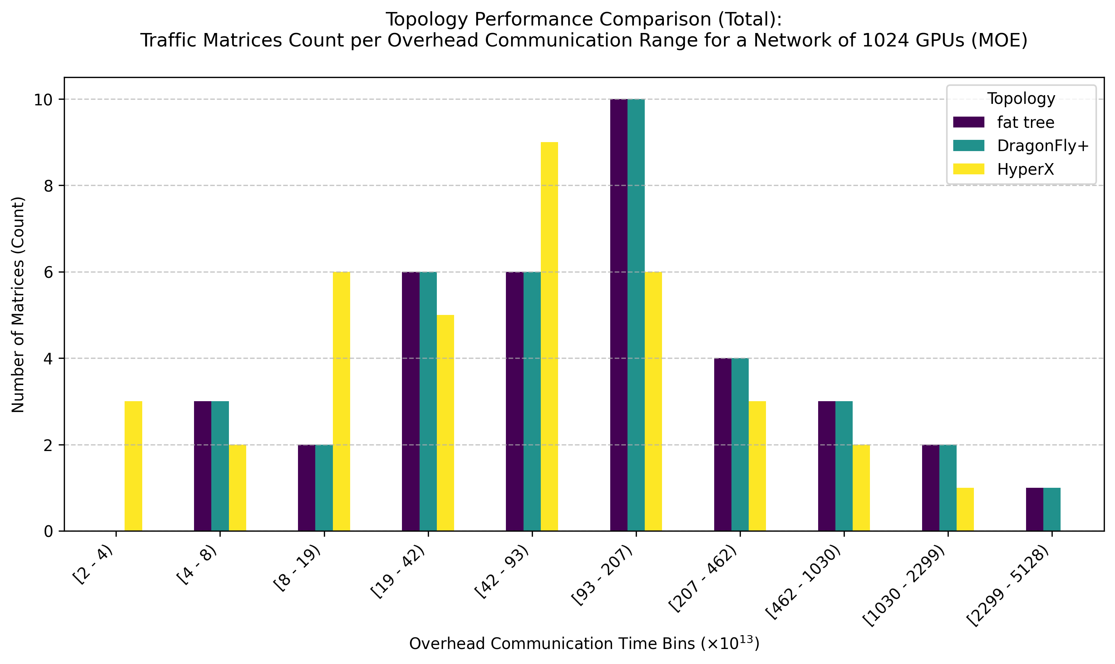
Models used:
GPT: 7,13,22,175B
Llama: 405B
World Sizes:
64
128
512
1024
2048
4096
Parallelism Methods:
Tensor Parallelism
Pipeline Parallelism
Data Parallelism
Expert Parallelism (MoE only)
Batch Size Parameters:
Global Batch Size
Micro Batch Size
Sequence Length
MoE Based Overhead Distribution
Over 1024 and 2048 World Sizes

Slide 5
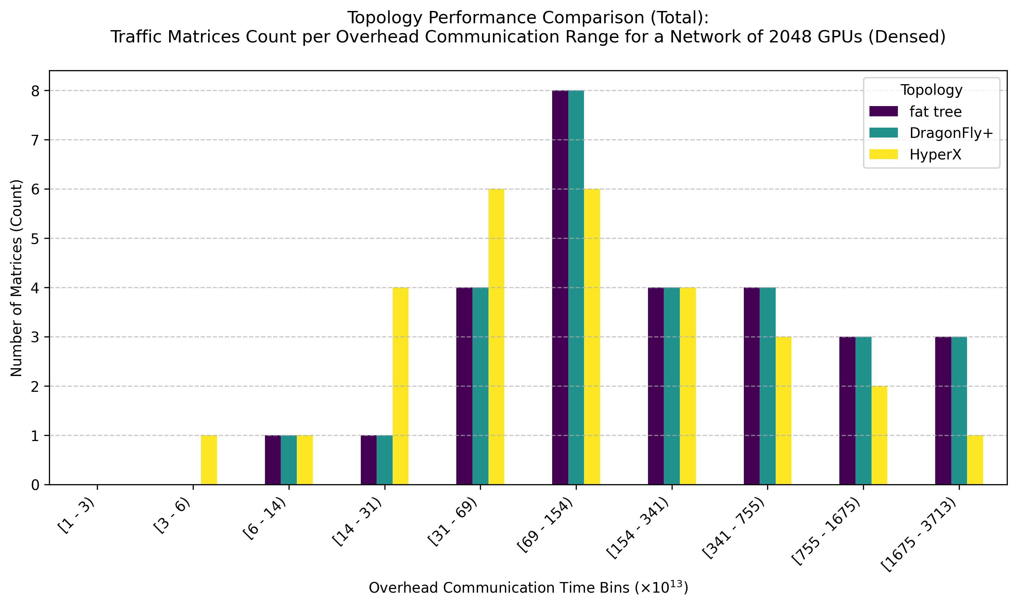
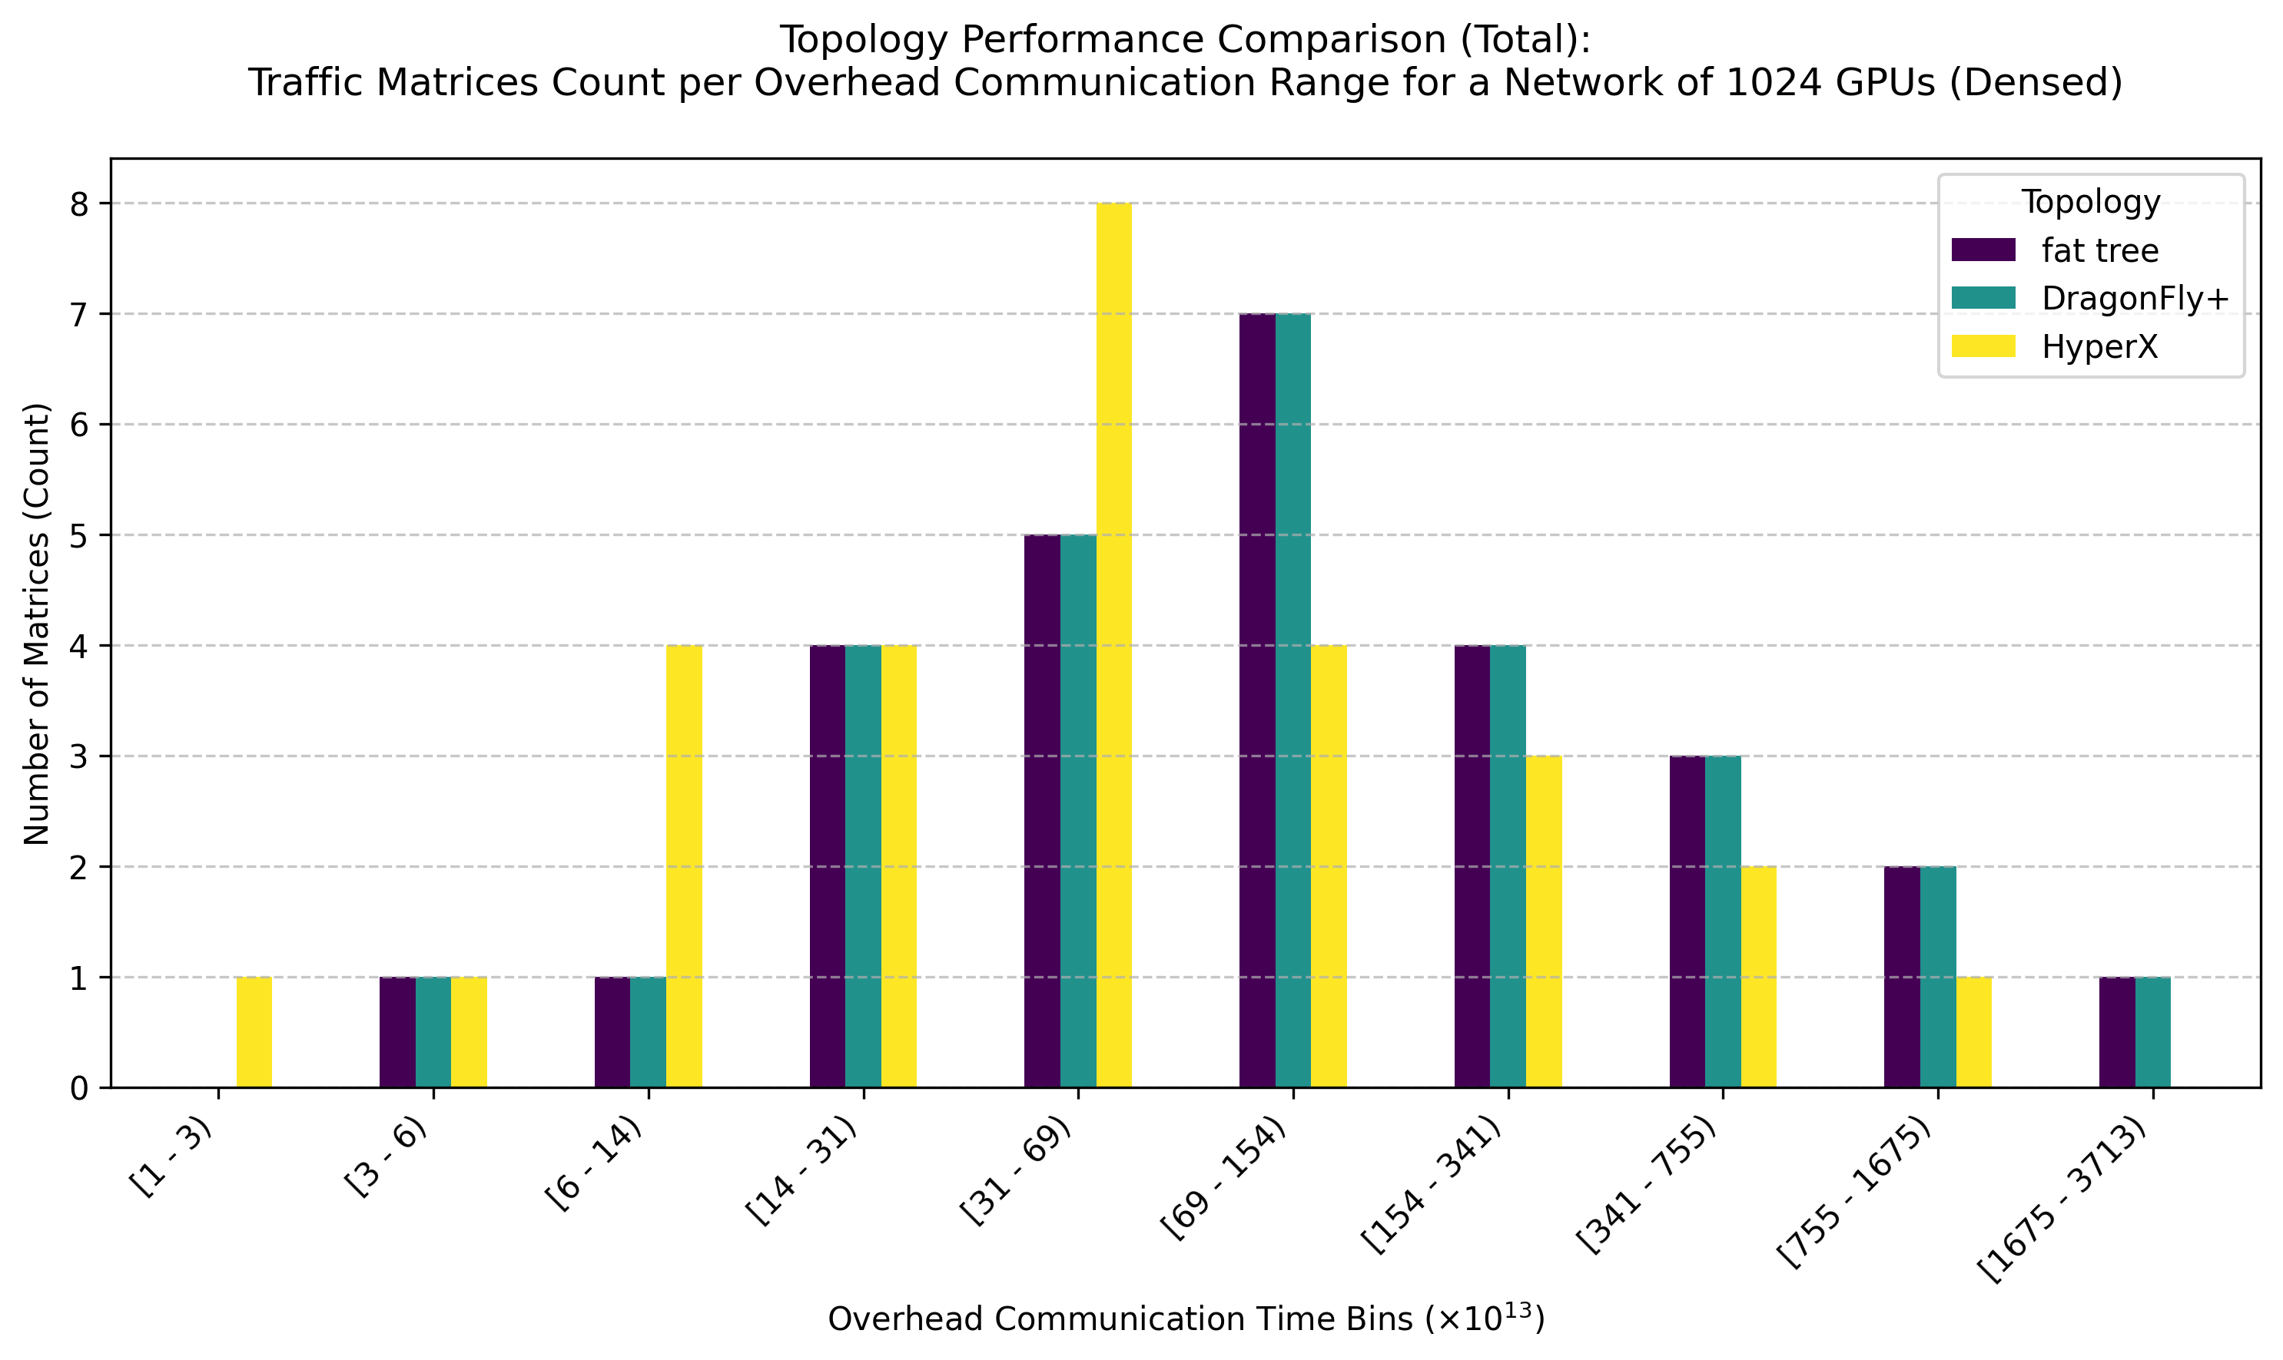
Models used:
GPT: 7,13,22,175B
Llama: 405B
World Sizes:
64
128
512
1024
2048
4096
Parallelism Methods:
Tensor Parallelism
Pipeline Parallelism
Data Parallelism
Expert Parallelism (MoE only)
Batch Size Parameters:
Global Batch Size
Micro Batch Size
Sequence Length
Dense Overhead Distribution
Over 1024 and 2048 World Sizes

Slide 6
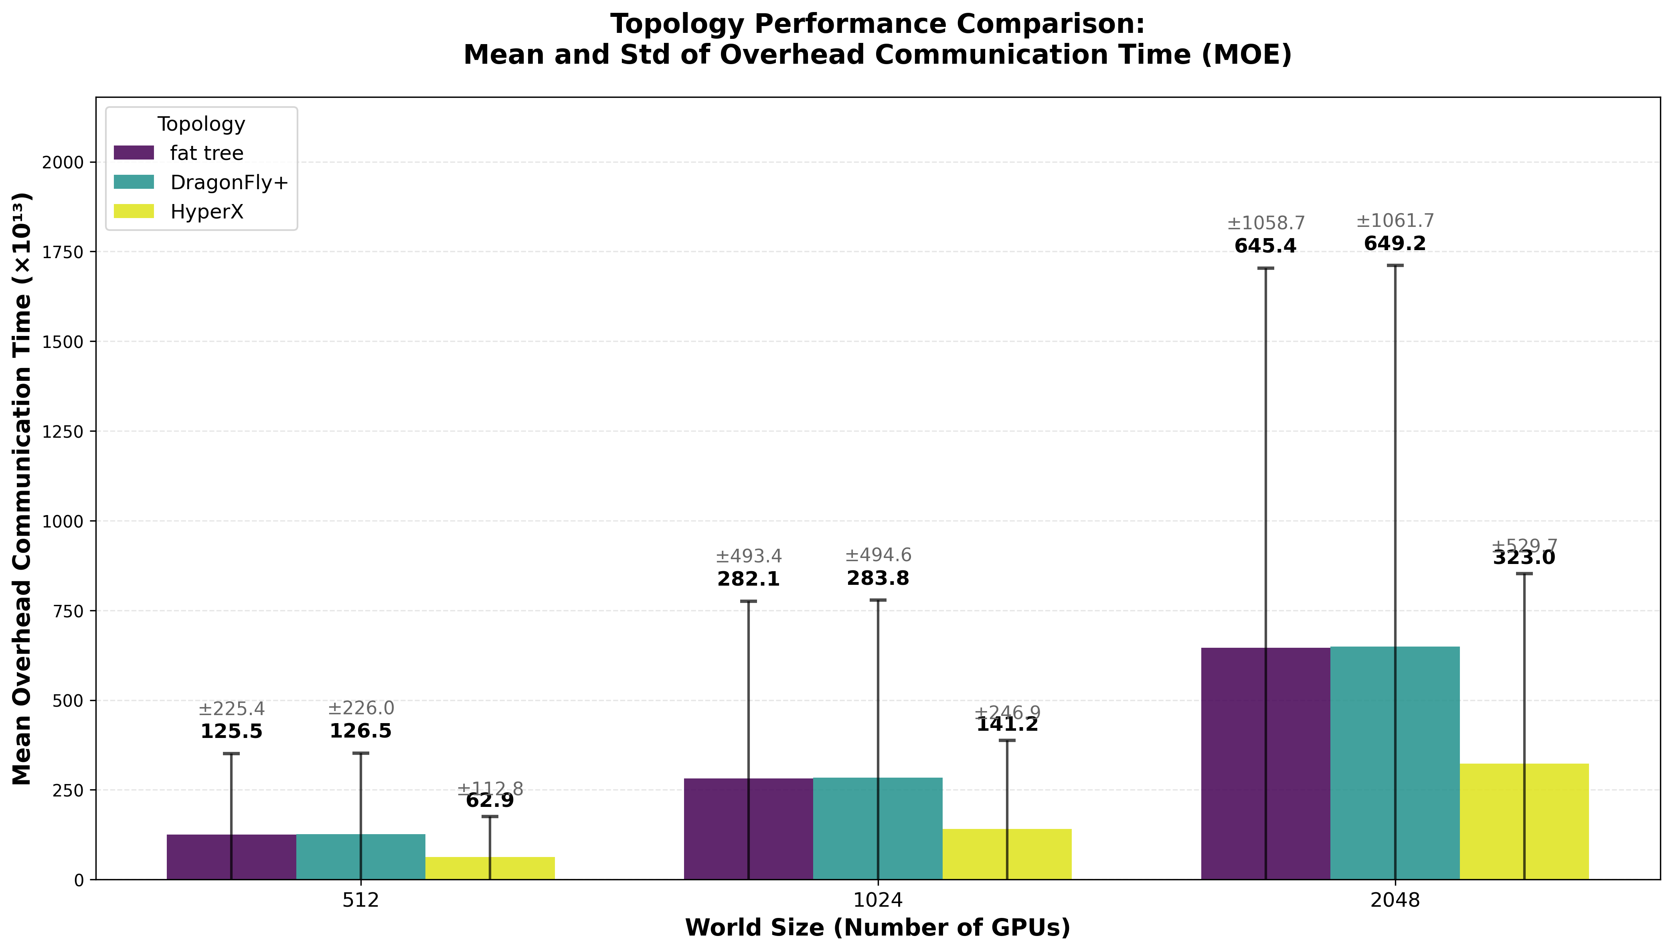
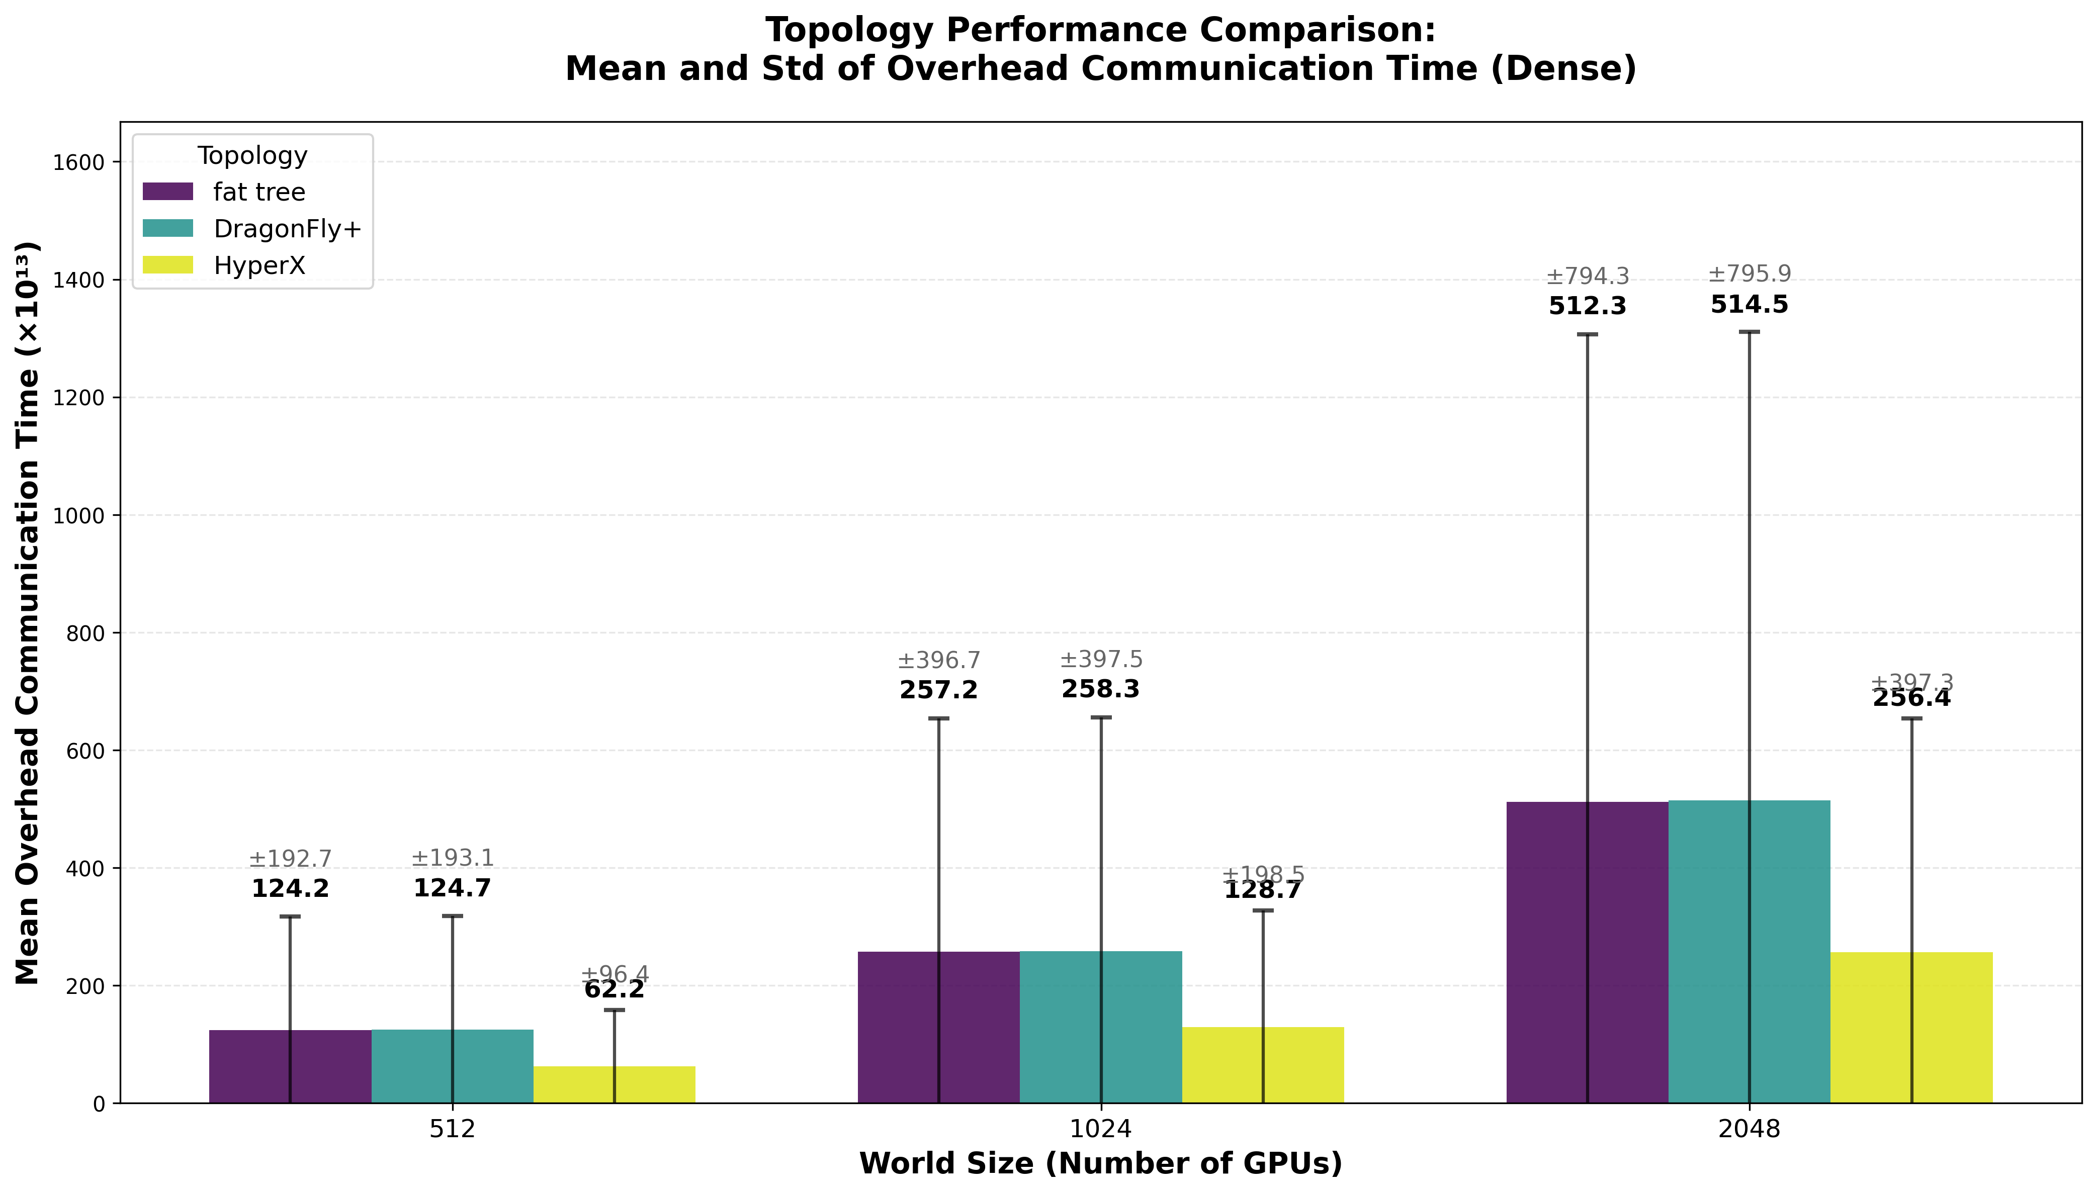
Models used:
GPT: 7,13,22,175B
Llama: 405B
World Sizes:
64
128
512
1024
2048
4096
Parallelism Methods:
Tensor Parallelism
Pipeline Parallelism
Data Parallelism
Expert Parallelism (MoE only)
Batch Size Parameters:
Global Batch Size
Micro Batch Size
Sequence Length
Overhead Distribution Comparison
Between MoE and Dense Architectures

